Slide 1



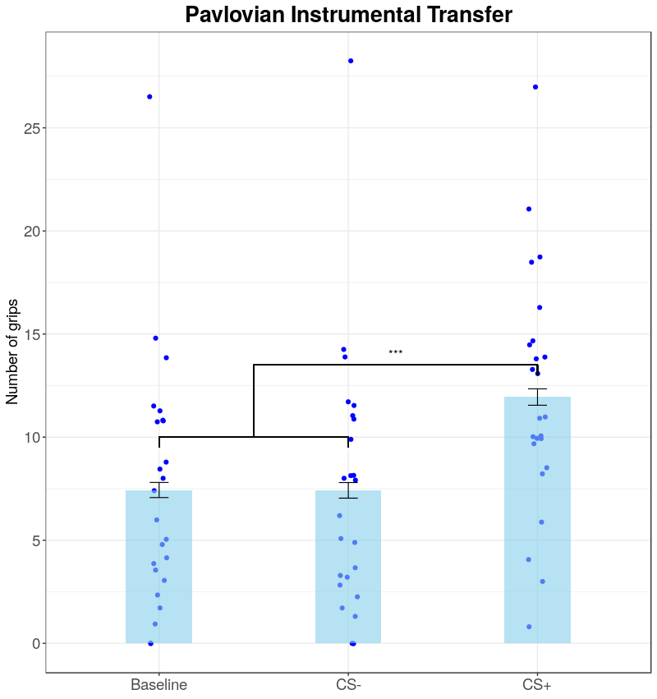
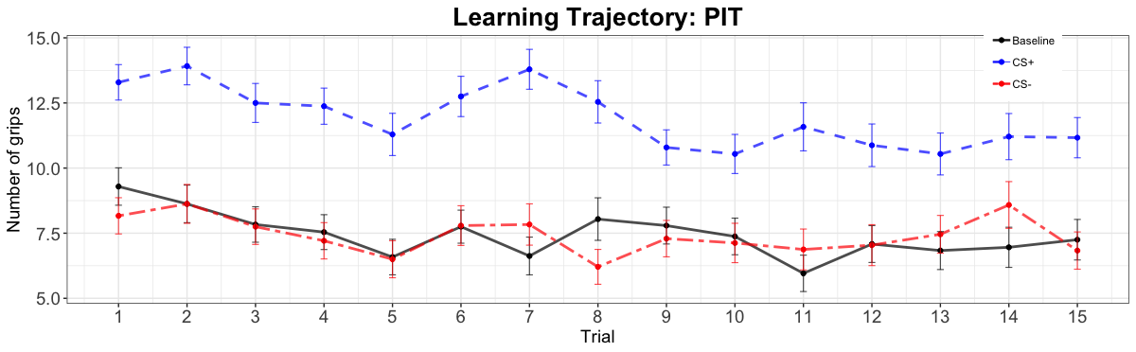
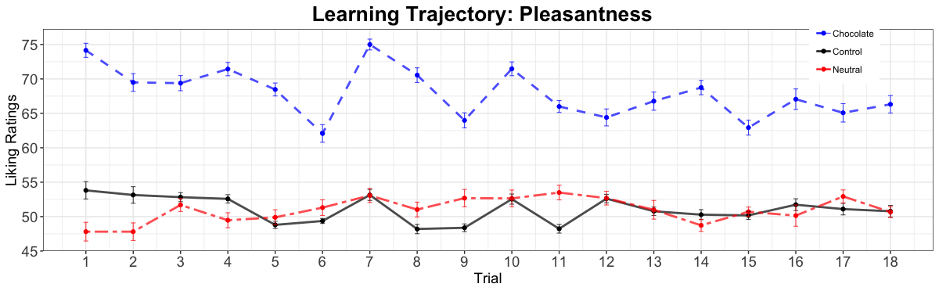
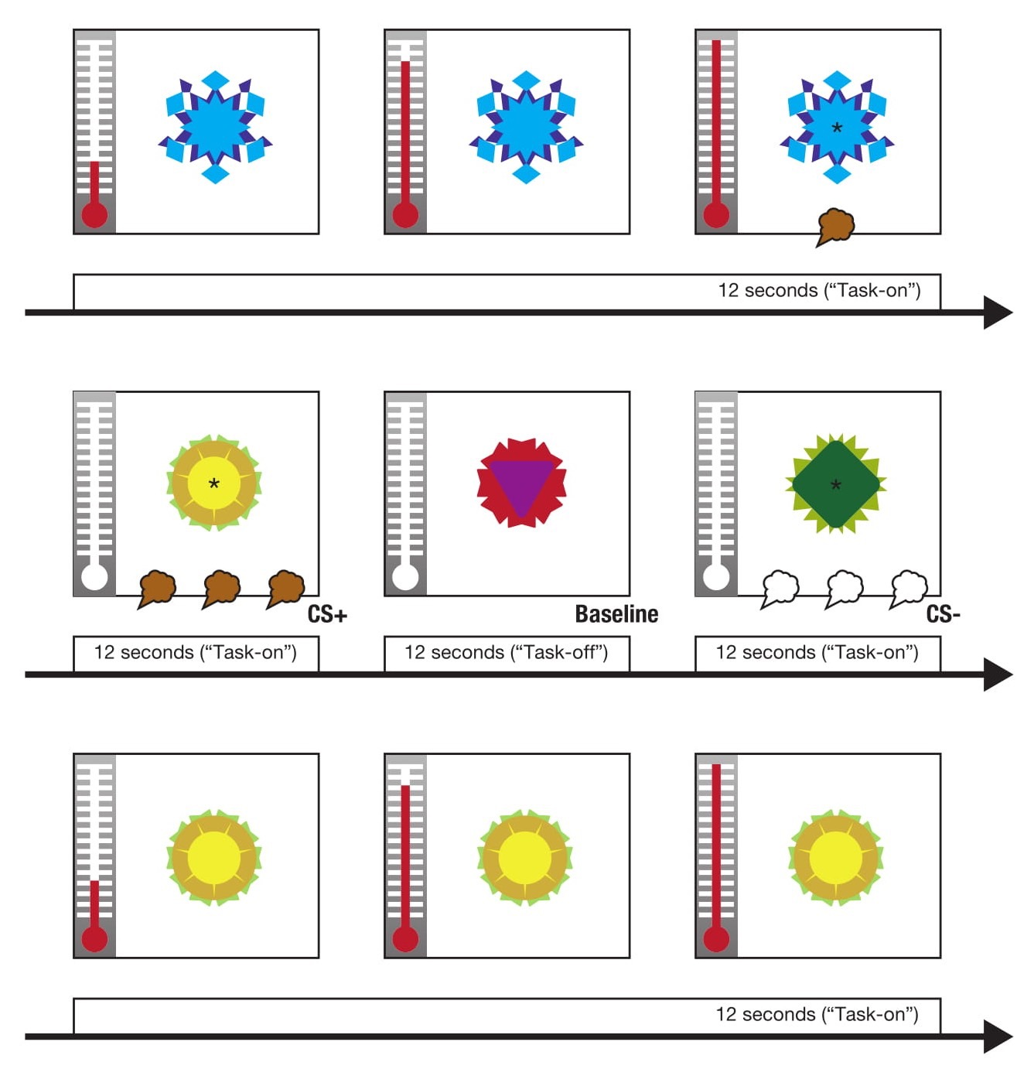
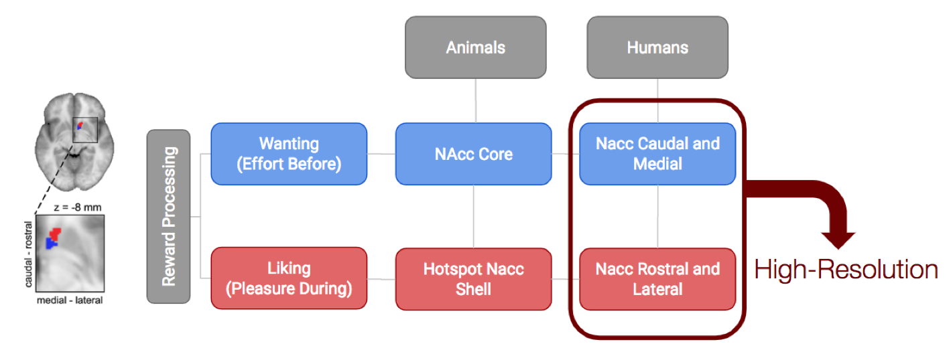
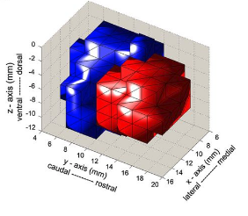
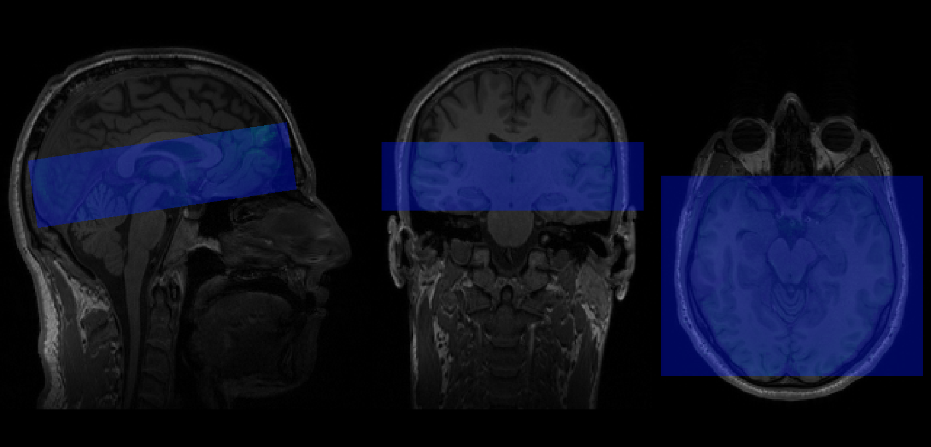
Wanting and Liking within the Human Ventral Striatum:
a “high-resolution” fMRI study
Muñoz Tord, D.¹²³: Pool, E.¹²³; Sander, D.¹²³
¹ University of Geneva, Emotion Elicitation and Expression Laboratory; ²University of Geneva, Swiss Center for Affective Sciences;
³University of Geneva, Faculté de Psychologie
Wanting and Liking within the Human Ventral Striatum:
a “high-resolution” fMRI study
Muñoz, D.¹²³; Pool, E.¹²³; Sander, D.¹²³
¹ University of Geneva, Emotion Elicitation and Expression Laboratory; ²University of Geneva, Swiss Center for Affective Sciences;
³University of Geneva, Faculté de Psychologie
Neuroscience Masters’ Day
INTRODUCTION
BEHAVIORAL RESULTS
The aim of the study is to disentangle salient motivation (how much the person invests energy to obtain a reward) and hedonic pleasure (how much a reward is liked)¹.
Animal studies² have succeed to dissociate the two components by manipulating the tonic dopamine release in the NAcc (nucleus accubens), however the existence of such a dissociation is still debated in humans.
This neuroimagining study aims to investigate the dissociation of reward processing in humans using a psychological manipulation rather than a brain manipulation.
The CS+ affected the number of grips (χ2 (1) = 11.192, p < .001), raising it by 4.52 ±0.4 SEM compared to the average of the other conditions (n=24).
The chocolate affected the perceived liking (χ2 (1) = 9.658, p < .001), raising it by 16.96 ±0.6 SEM comparing to the average of the other conditions (n=24).
A
METHOD
B
Time
Subjects:
Twenty-four right-handed undergraduate students from Geneva (18–36 y/o) who like chocolate.
Stimuli:
Three different complex geometrical figures where used as visual stimuli.
Twelve odor stimuli³.
Task: Analog of a human Pavlovian-Instrumental Transfer (PIT) paradigm⁴.
Learning to squeeze a hand dynamo-meter to trigger the release of a rewarding chocolate odor.
Fig 3. Learning and time trajectories for both tasks.
(A) Average number of grips per condition over time. Error bars indicate mean ±0.5 SEM.
(B) Average ratings of the pleasantness of the stimuli per condition over time. Error bars indicate mean ±0.5 SEM.
Fig. 2. Means of the numbers of grips during the PIT per condition with individual data. Error bars indicate mean ±1 SEM.
PREDICTIONS AND PLANNED ANALYSIS
Exposition to repeated pairings of the positive conditioned stimulus (CS+) with the rewarding chocolate odor and the negative conditioned stimulus (CS-) with the odorless air. When the CS+ or CS- was displayed, a target appeared in the center and participants had to press a key that triggered odor release. The baseline was displayed without any target, and no odor was released.
Under extinction, the conditions were displayed in random order. The participants could squeeze the handgrip if they wished to do so.
The caudal and medial parts of the NAcc (core) will correlate more with the Pavlovian Instrumental Transfer.
The rostral and lateral parts of the NAcc (shell) will correlate more with the behavioral index of hedonic pleasure.
(a) Instrumental conditioning task
(b) Analog of a Pavlovian conditioning task
A
B
C
(c) Pavlovian-Instrumental Transfer (PIT)
Fig. 1. Example of a PIT CS+ trial⁵.
Procedure: The experiment took place over two separate days in the Brain Behavior Lab in Geneva.
The first day we checked our manipulations by making our participants complete the two first phases (a) and (b) and evaluate the intensity and liking of each of the 12 odor stimuli.
The second day happened in the scanner where participants had to accomplish the complete PIT task while also re-evaluating the odor stimuli.
Behavioral Data Analysis: We used the lme4⁶ package on R to perform a linear mixed effect analysis with planned contrasts.
We looked at the relationship between the behavioral PIT and the salient motivation of the participant. Our dependent variable was the number of grips and our fixed effects was the experimental conditions (CS-, CS+ and Baseline). As random effects, we had intercepts for subjects and trials, as well as by-subject random slopes.
We also checked that our manipulation of the behavioral index of hedonic pleasure was valid. Our dependent variable was the reported pleasantness of the stimuli and our fixed effects were the odors (Control, Neutral and Chocolate). We also added random effects intervals and slopes.
Fig. 4. (A) DTI clustering of the right NAcc into two subdivision adapted from Baliki et al. (2013)⁷. (B) Diagram representation of our hypothesis following animal studies (C) Three-dimensional rendering of NAcc’s core and shell⁷.
We are currently working on the analysis of our neuroimaging data.
Fig. 5. A sample of our imaging data. 26 Partial EPI (blue) on top of a anatomical T1 (grey). TR = 2400, TE = 41, 1.8 voxel isometric.
REFERENCES
Contact: David.munoz@etu.unige.ch
¹Robinson, T. E., & Berridge, K. C. (1993). The neural basis of drug craving: an incentive-sensitization theory of addiction. Brain research reviews, 18(3), 247-291.
²Peciña, S., Schulkin, J., & Berridge, K. C. (2006). Nucleus accumbens corticotropin-releasing factor increases cue-triggered motivation for sucrose reward: paradoxical positive incentive effects in stress?. BMC biology, 4(1), 8.
³Delplanque, S., Grandjean, D., Chrea, C., Aymard, L., Cayeux, I., Le Calve, B., & Sander, D. (2008). Emotional processing of odors: evidence for a nonlinear relation between pleasantness and familiarity evaluations. Chemical Senses, 33(5), 469-479.
⁴Talmi, D., Seymour, B., Dayan, P., & Dolan, R. J. (2008). Human Pavlovian–instrumental transfer. Journal of Neuroscience, 28(2), 360-368.
⁵Pool, E., Brosch, T., Delplanque, S., & Sander, D. (2015). Stress increases cue-triggered “wanting” for sweet reward in humans. Journal of Experimental Psychology: Animal Learning and Cognition, 41(2), 128.
⁶Bates, D., Mächler, M., Bolker, B., & Walker, S. (2014). Fitting linear mixed-effects models using lme4. Journal of Statistical Software, 67(1), 1-48.
⁷Baliki, M. N., Mansour, A., Baria, A. T., Huang, L., Berger, S. E., Fields, H. L., & Apkarian, A. V. (2013). Parceling human accumbens into putative core and shell dissociates encoding of values for reward and pain. Journal of Neuroscience, 33(41), 16383-16393.

Slide 2
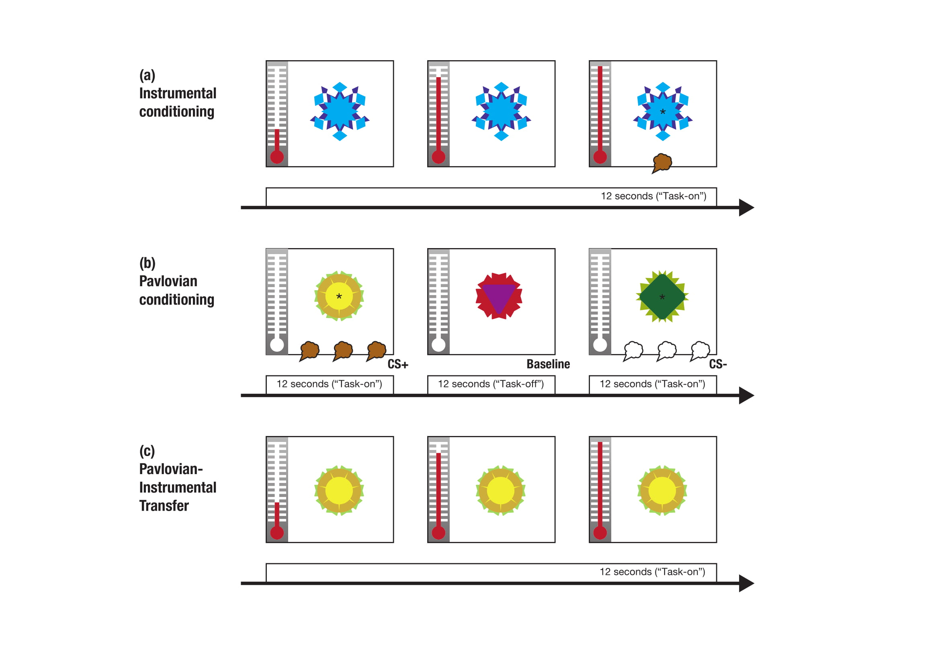
(a) Instrumental conditioning task
(b) Analog of a Pavlovian conditioning task
(c) Pavlovian-Instrumental Transfer (PIT)

